Slide 1
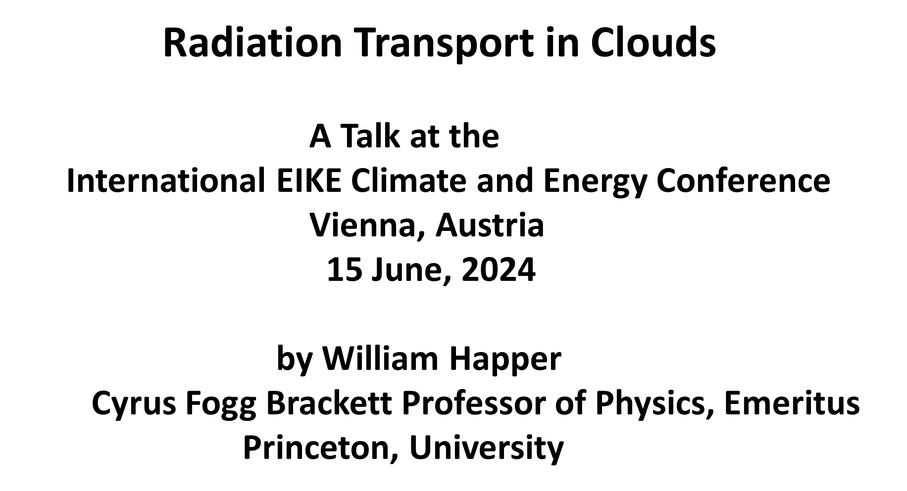
Notes:
Let me begin by thanking the conference organizers for inviting me to the storied city of Vienna, the home of Stefan, Boltzmann, Doppler, Mach and many other heroes of international physics.
I am going to sketch some details of how radiative heat transfer works in Earth’s clouds. Hendrick Svensmark, Nir Shaviv, John Clauser and others have already discussed how important clouds are, compared to greenhouse gases.
But let me make one thing clear at the outset. There is no climate crisis and there will not be a climate crisis from the increases of atmospheric greenhouse gases. The forcings are too small, about a 1% decrease of radiation to space for a 100% increase (doubling) of CO₂ concentrations. The resulting warming will be very small and will probably be a net benefit to life on Earth. And agriculture, forestry and all photosynthetic life will greatly benefit from more of the plant food, CO₂.
No doubt some proponents of the myth of a climate crisis are sincere, if misguided. However, many others support the myth out of a lust for power and wealth. Alas, this has happened all too often in human history. Emmanuel Kant got it right; “Aus so krummen Holtze, als woraus der Mensch gemacht ist, kann nichts ganz Gerades gezimmert werden.” Isaiah Berlin’s English translation is: “Out of the crooked timber of humanity, no straight thing was ever made.”

Slide 2
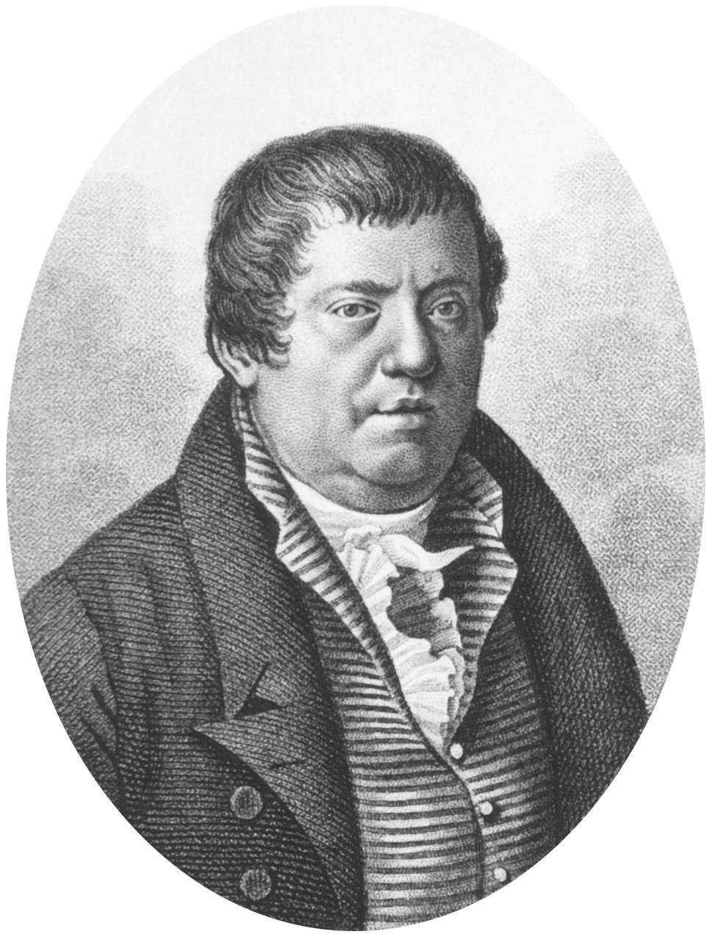
John Leslie
Scottish Physicist
1766-1832
Leslie’s Aethrioscope
“The sensibility of the instrument is very striking, for the liquor incessantly falls and rises in the stem with every passing cloud. In fine weather, the aethrioscope will seldom indicate a frigorific impression of less than 30 or more than 80 millesimal degrees. If the sky become overclouded, may be reduce to as low as 15º or even 5º when the congregated vapours hover on the hilly tracts.”
A Short Account of Experiments and Instruments, Depending on the Relations of Air to Heat and ... : John Leslie : Free Download, Borrow, and Streaming : Internet Archive
Notes:
Some of the earliest quantitative work on radiative transfer and clouds was done by the Scottish physicist, John Leslie. He was the first to make quantitative measurements of downwelling radiation from the daytime and nighttime sky, that is, of the “sky temperature.” To do this he used a sensitive differential thermometer, which he called an “aethrioscope,” and which is shown here. It consisted of two spherical glass bulbs, connected by a capillary tube containing a short column of alcohol (liquor) in the midsection. The lower bulb was shielded from radiation and was held at room temperature. The upper bulb was at the focus of a parabolic reflector, a polished metal cup, which let downward radiation focus on the bulb and heat it. Vice versa, thermal radiation emitted from the bulb was projected into the sky above. The cup played much the same role as the dish antenna of a modern radar. The colder the apparent sky temperature, the higher the column of liquor would be forced upward toward the absorbing-emitting bulb.
Working with the aethrioscope around the year 1800 Leslie noticed the substantial increases and decreases of downwelling radiation as clouds passed over head, and as described by his words on the viewgraph.

Slide 3
Notes:
Even in the year 1800, Leslie was well aware that there were two kinds of radiation in the atmosphere, sunlight which you could see, and thermal radiation generated in the atmosphere, which I will call earthglow, which you could not see but could feel as radiant heat if it were strong enough. This viewgraph shows the spectral probability density for sunlight as the blue curve, P_{s} and for earthglow as the red curve P_{e.} The increment dW_{i} = P_{i} d log λ is the infinitesimal probability to find the radiation energy of sunlight (i=s) or earthglow (i = e) with wavelengths corresponding to the interval between log λ and log λ +d log λ .
There is very little overlap between the two probability densities, which are equal at a wavelength of about λ= 4.2 μm, which can serve as convenient boundary between “short wave” radiation or sunlight, and “long wave” thermal radiation or earthglow emitted by Earth’s surface and atmosphere.
The probability curves assume thermal radiation at a temperature of T_{s} = 5772 K for sunlight and T_{e} = 288.7 K for earthglow.
As indicated on the viewgraph, the two types of radiation can be measured with two types of instruments, a pyranometer for sunlight and a pyrgeometer for earthglow.

Slide 4
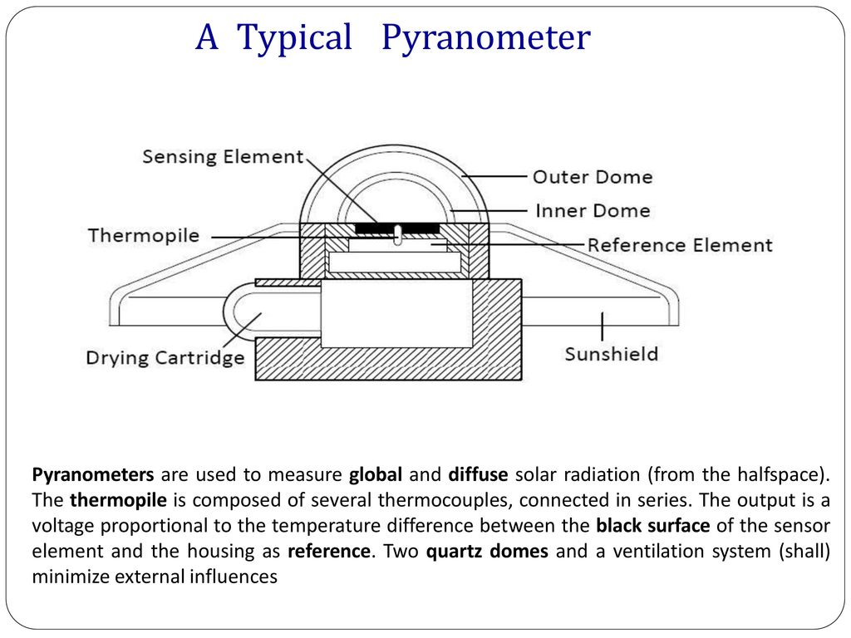
(measures sunlight)
Notes:
Leslie’s aetherioscope was sensitive to both direct and scattered sunlight and also to thermal radiation emitted by clouds and greenhouse gases. It detected radiation from a relatively narrow range of directions near the vertical. One modern instrument that has evolved from the aetherioscope is the pyranometer, an example of which is sketched on this viewgraph.
Pyranometers are designed to measure solar radiation downwelling from all directions, both direct radiation from the Sun and solar radiation that has been diffusely scattered by clouds and by atmosphere gases. The pyranometer is insensitive to thermal infrared radiation, with wavelengths longer than about 4.2 micrometers. Greenhouse gases have little direct effect on pyranometer measurements, since greenhouse gases are nearly transparent to solar radiation, and they mainly interact with thermal radiation that the pyranometer cannot see.

Slide 5
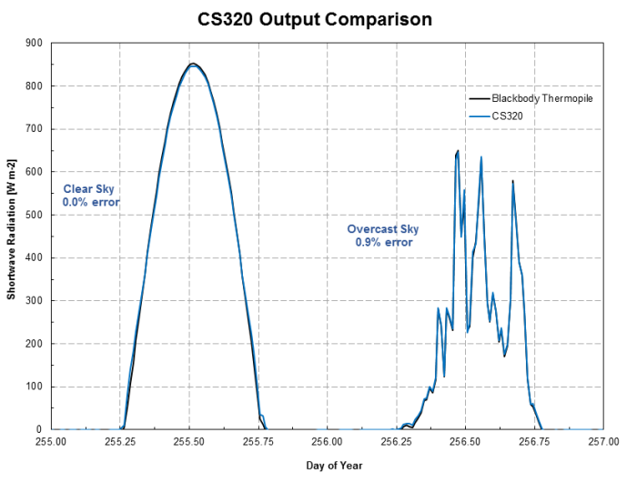
Pyranometer Measurements of Solar Flux on Earth’s surface
Utah, USA
August
Day
Night
Day
https://www.campbellsci.ca/blog/measuring-sun-accurately-simply
Notes:
This viewgraph was generated by a pyranometer manufacturer. It shows that for measuring solar radiation, an instrument built with a sensitive photoelectric detector, CS320, works as well as one with a much less sensitive thermopile. Some very elegant engineering was needed to properly calibrate the device and make it work.
For our discussions, the main point is to show that an ideal pyranometer is insensitive to the long wave thermal radiation from greenhouse gases and clouds, radiation that continues to downwell, day and night. The pyranometer shows no signal at all during the night when there is no solar radiation. Moonlight and starlight is more than one hundred thousand times weaker than sunlight and can be neglected. The viewgraph also shows the dramatic difference of downwelling solar radiation for a clear day on the left, and for a cloudy day on the right. During occasional cloud breaks when the sun can reach the ground directly, the downwelling solar radiation spikes upward. When clouds return to shadow the sun, the downwelling radiation comes from diffuse sunlight that has had multiple scattering on cloud particulates before reaching the pyranometer. Much of the radiation is reflected back to space and does not heat the ground or the atmosphere.

Slide 6
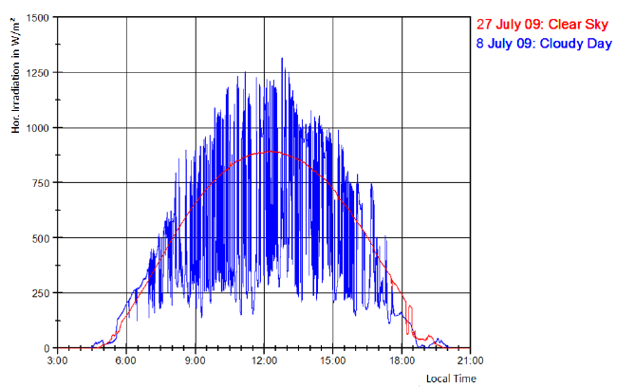
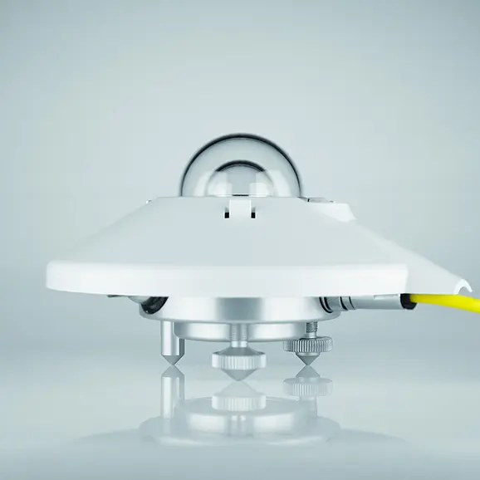
Clouds Can Enhance Solar Irradiance on Earth’s Surface
Kipp & Zonen CMP22 Pyranometer
Munich,
Germany
https://www.researchgate.net/publication/237353475_Systematic_Analysis_of_Meteorological_Irradiation_Effects/figures?lo=1
Notes:
But Mother Nature is subtle. Paradoxically, skies with lots of clouds can increase the solar flux on some ground patches while decreasing it on others. The highly reflecting water droplets of the cloud edges forward-scatter sunlight and add to the direct irradiance from the sun.
The solar flux on a partly cloudy day is shown as the jagged blue curve on the viewgraph. The same viewgraph shows the pyranometer output on a clear day. The drifting clouds can not only decrease the solar flux on the ground, compared to that on a clear day, but they can increase it by many tens of per cent.
On average, scattered clouds decrease solar flux on Earth’s surface, but for time intervals of a few minutes, they can increase the flux substantially, compared to a clear day.

Slide 7
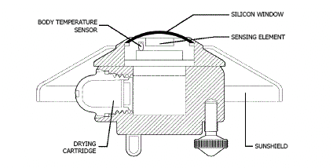
A “Solar Blind” Pyrgeometer to Measure Downwelling
Thermal Radiation Flux from Greenhouse Gases and Clouds
(Measures Earthglow)
Notes:
An instrument that compliments the pyranometer is the pyrgeometer, which is designed to see only the downwelling flux from thermal emission by greenhouse gases and clouds in the atmosphere. A silicon dome and thin-film spectral filters prevent all solar radiation from reaching the detector, which is “solar blind.” But the dome and filters admit most radiation with wavelengths between 4.2 to 50 micrometers, which includes nearly all atmospheric thermal radiation or earthglow.
Upward thermal radiation emitted from the detector surface can pass back through the filters and dome into the cold sky. Since the sky is normally colder than the pyrgeometer, the upward-facing detector surface will normally be colder than the bottom. A modern pyrgeometer is designed to do just what John Leslie’s aethrioscope did, to measure how cold the sky is.

Slide 8
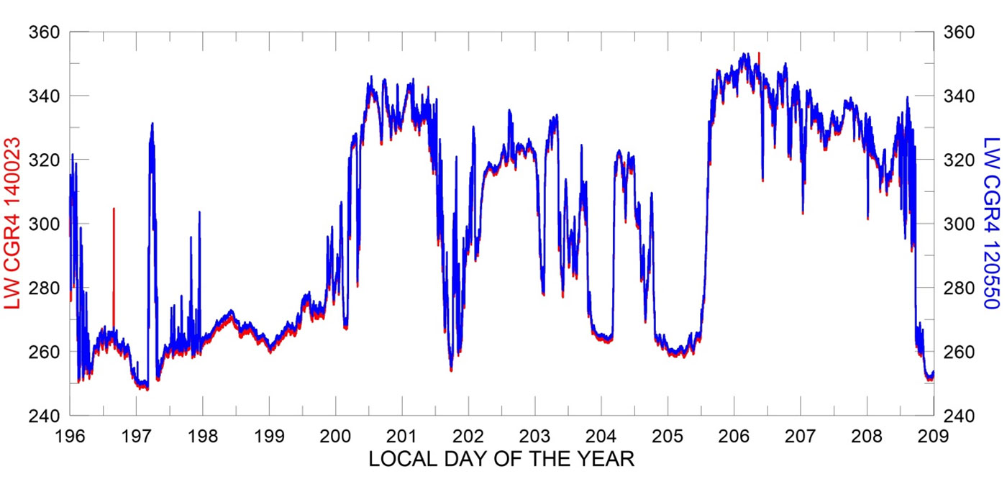
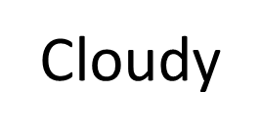
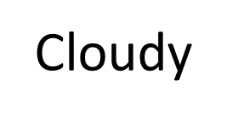
Thermal Downwelling Pyrgeometer Measurements in Thule (W m⁻²)
Cloudy
Wm⁻²
Clear
Cloudy
Clear
Cloudy
Clear
Clear
https://www.thuleatmos-it.it/instruments/radiometers/index.php
Notes:
This viewgraph shows a two-week recording of downwelling thermal radiation measured with a pyrgeometer at Thule, Greenland in July. There is very little variation of downwelling radiation from day to night. But there is a large difference between clear and cloudy weather, with close to 340 Wm⁻² downwelling from cloud bottoms on overcast days and around 260 Wm⁻² in clear weather, where the downwelling comes from thermal emission of water vapor, H₂O, and CO₂. The cloud bottoms produce the same flux as a blackbody with a temperature of about 5 C. The clear sky produces the same flux as a blackbody with a temperature of about -13 C.
Note the suppressed zero on the vertical scale! The downwelling from cloudy skies is only about 30% greater than that from clear skies.

Slide 9
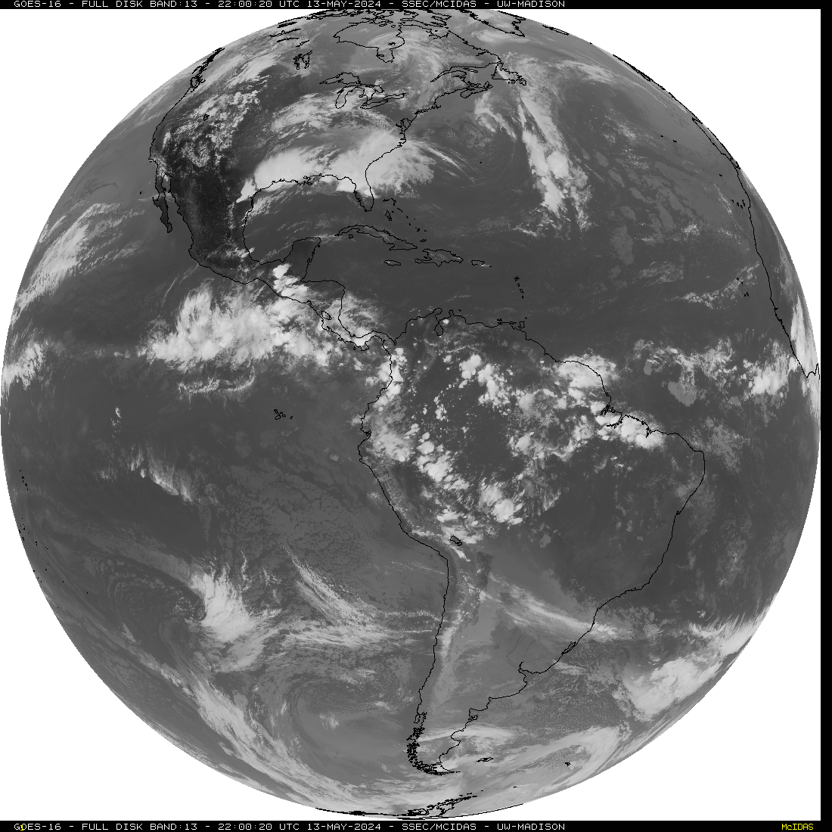
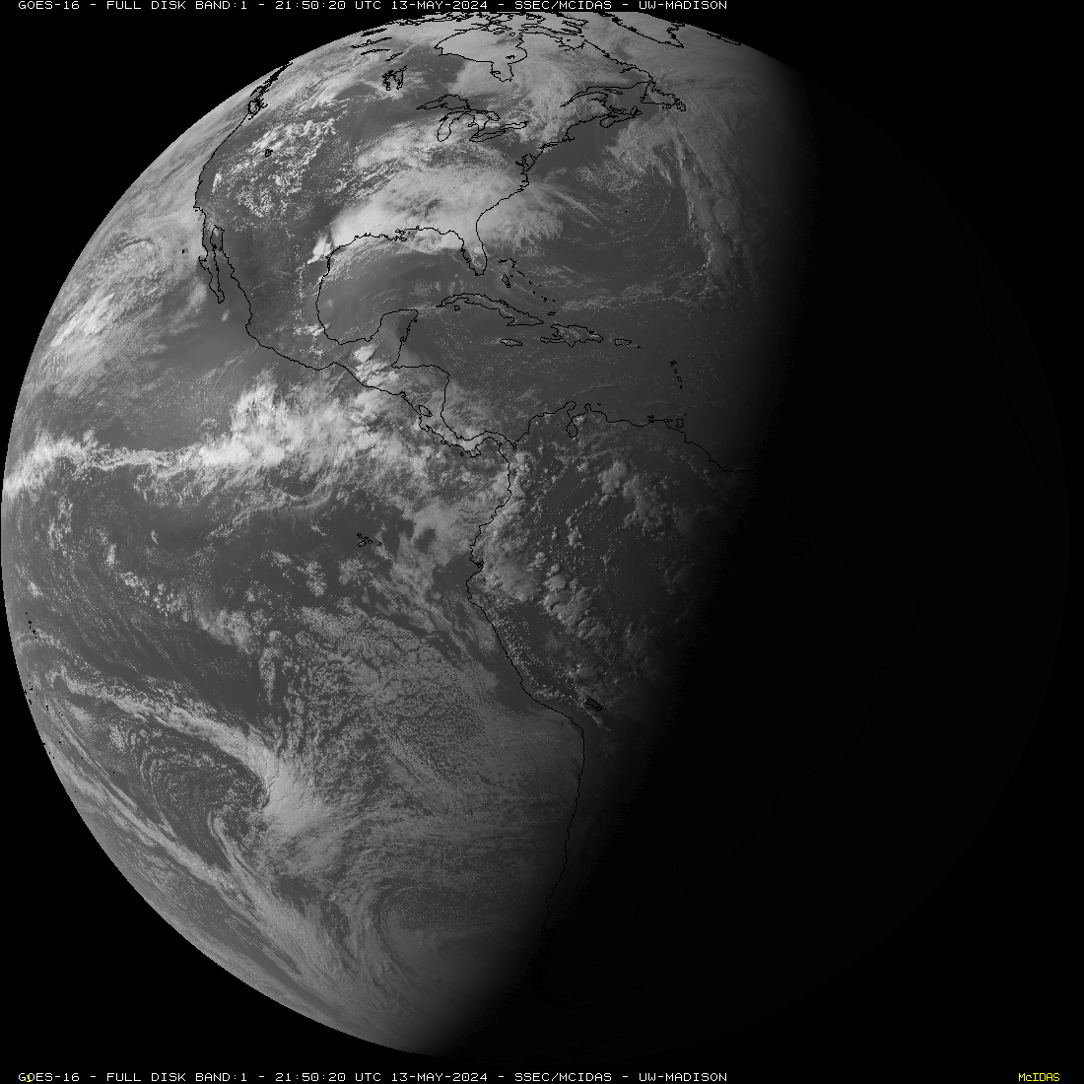
Earth glowing in the dark at a wavelength of 10.3 μm.
The right, nighttime side is just as bright as the left, sunlit side. White cloud tops are cold and emit very little radiation.
Warmer land and oceans emit copious radiation.
Reflected blue sunlight of wavelength 0.47 μm, recorded at the same time from the same satellite. White cloud tops reflect lots of sunlight. Land and oceans reflect less.
https://www.ssec.wisc.edu/data/geo/#/animation 6:12 pm Princeton Time, 13 May, 2024
Notes:
The previous viewgraphs show downwelling radiation onto Earth’s surface. But upwelling radiation to space is qualitatively similar. Shown here are longwave infrared and visible images of the Earth, recorded at the same time by a geosynchronous satellite parked in the equatorial plane above Ecuador.
The right side of the figure show blue sunlight, at wavelength of 0.47 micrometers diffusely reflected in the late afternoon when the time was 6:12 pm in Princeton, NJ. Night has already descended on Europe and the eastern Atlantic so the right side of the image appears black
The left side of the figure shows that Earth “glows in the dark,” at a wavelength of 10.3 micrometers, in the “infrared window,” where there is little absorption by greenhouse gases in cloud-free skies. So much heat is stored up from the previous day that the nighttime side of the globe on the right is just as bright with longwave radiation as the daytime side on the left. Like the pyrgeometer measurements of downward earthglow in the previous viewgraph, the earthglow seen from space has nearly the same intensity day or night.

Slide 10
Modelled Spectra Can Hardly Be Distinguished From Measured Spectra.
https://arxiv.org/pdf/2006.03098
Notes:
If one records the long wave thermal infrared radiation that reaches the satellite from a cloud-free area of the Earth, spectra like those on the right column of this figure are found. On the left are theoretically modelled spectra. One can hardly tell the difference between the modeled and observed spectra
Note the strong dependence of the spectra on latitude. The vertical scales on the figures are different. The wintertime Antarctic, shown in the bottom row, emits much less radiation to space than the summertime Sahara shown in the top row. The modeled spectra on the left also include a dashed red Plank intensity spectrum, the radiation that a black surface at the same temperature as the real surface would emit to space if there were no greenhouse gases.
Over the Sahara and the Mediterranean, the greenhouse gases H₂O, CO₂ , and O₃, ozone, diminish the radiation reaching the satellite compared to Planck radiation from the surface. Over Antarctica, these greenhouse gases increase the radiation to space, compared to an atmosphere with no greenhouse gases.
The next viewgraph has a little more information about the Schwarzschild equation that was used for the model calculations.

Slide 11
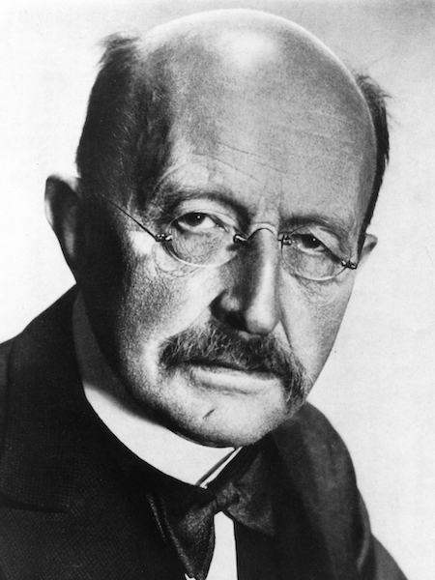
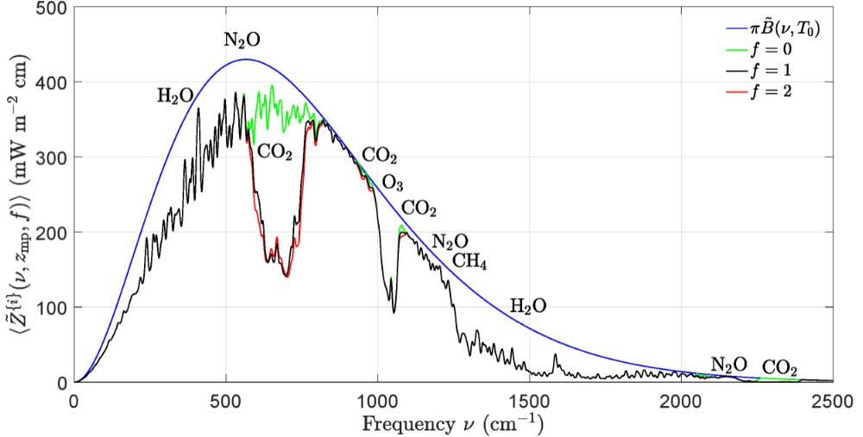
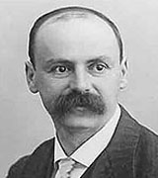
Area = 394 W/m²
Area = 307 W/m²
--- transparent atmosphere
--- CO₂ = 0 ppm
--- CO₂ = 400 ppm
--- CO₂ = 800 ppm
Max Planck
1858-1947
Area = 274 W/m²
Area = 277 W/m²
Karl Schwarzschild
1873-1916
https://arxiv.org/pdf/2006.03098
Notes:
Quantitative analyses of greenhouse warming were made possible by Max Planck’s discovery of quantum physics in the year 1906. Planck’s famous blackbody spectrum is shown as the blue line in the viewgraph above. The area under the blue curve is how much heat radiation would be emitted to space from each square meter of Earth’s surface, at a mean temperature of 15.5 C. A photo of Max Planck is included in the upper right.
Because of greenhouse gases, the heat radiated by Earth to space is not 394 watts per square meter, the area under the Planck’s smooth, blue curve. Instead, the power radiated is only 277 watts per square meter, the area under the jagged black curve. This is just enough to balance solar heating, any heat transport in horizontal directions and any increase or decrease of the internal energy of the atmosphere and surface.
It is appropriate to call the black curve the Schwarzschild intensity, in honor of Karl Schwarzschild, whose photo is shown on the lower right of the figure. The basic equation of radiative heat transfer in cloud-free atmospheres with greenhouse gases is called the Schwarzschild equation, since Schwarzschild showed how to include greenhouse gases into the theory of radiation transfer. He was interested in energy transfer in the Sun and stars, not Earth’s atmosphere, but the same theory works for both. The Schwarzschild equation is shown at the top of the viewgraph.
Schwarzschild’s theory shows that heat radiation to space from a semi-transparent atmosphere can come mostly from the surface, for frequencies that are weakly absorbed by greenhouse gases. But for frequencies that are heavily absorbed, most of the heat radiation to space is emitted by greenhouse molecules from altitudes of several kilometers. It is not attenuated thermal radiation emitted by Earth’s surface.
In addition to the blue Planck curve for a transparent atmosphere and the black Schwarzschild curve for an atmosphere with current concentrations of greenhouse gases, there is a green curve, which shows what happens if you could suddenly remove all of the CO₂ from the atmosphere. Removing all the carbon dioxide would increase the radiation to space substantially, by about 30 watts per square meter, the area between the green and black curve on the top panel.
Finally, there is a red curve which is the radiation emitted to space if you double the CO₂ concentration. For most frequencies, the red and black curves are identical. But in the middle of the absorption bands you can see that the red and black curves differ slightly. The difference is hardly noticeable and amounts to a decrease of radiation to space of about 3.0 watts per square meter or 1% for doubling CO₂ concentrations from 400 ppm to 800 ppm. Any doubling of CO_{2,} a 100% increase, reduces radiation to space by the same 3.0 watts per square meter.

Slide 12
Radiation inside and outside of clouds can be modelled
very accurately with the formidable
“Equation of Transfer”
This integro differential equation is too complicated to discuss in detail today,
but I will try to give the flavor of how to solve it.
For more details, see these links to papers by W. van Wijngaarden and W. Happer
http://arxiv.org/abs/2205.09713 2n-Stream Radiative Transfer
http://arxiv.org/abs/2310.10622 Radiative Transfer in Cloud Layers
Notes:
Having reviewed some of the physical facts about how clouds affect radiation transfer, and how well solutions of the Schwarzschild equation describe cloud-free conditions, we turn to the modeling of radiation transfer in cloudy skies. I hope those in the audience who are uncomfortable with equations will forgive me for taking a little time to talk about mathematical details of modelling. A few colleagues here today may be interested.
With or without clouds atmospheric radiation transfer is described to high accuracy with the formidable equation of transfer shown on this viewgraph. This is an integro differential equation that allows one to accurately calculate how the radiation intensity varies with location inside or outside of a cloud and also how it varies with direction of the radiation.
For thermal radiation, that is, for earthglow, and for no clouds, the single scattering albedo, denoted by the symbol ω, is zero since molecules have negligibly small scattering cross sections. Then the radiation transfer equation simplifies to the Schwarzschild equation for cloud free skies, which we mentioned in the previous viewgraph.
In the next viewgraph, I will say a little more about what the symbols in the full equation of transfer mean.

Slide 13
Notes:
The independent variables for the equation of transfer are the location r and the directional unit vector n. The symbol I(r, n) denotes the unknown intensity at the location r, along the direction of the unit vector n.
The “known” parameters are the attenuation rate α, the single-scattering albedo ω, the Planck intensity B and the scattering phase function p or differential scattering cross section for scattering radiation from the direction n’ to the direction n.
Despite the vast funds poured into climate research, the properties of clouds needed to solve the equation of transfer can only be described as “knowns” in quotation marks. Single scattering albedos, ω, phase functions, p, attenuation coefficients α, and other properties of cloud particulates are not very well known from experimental observations.

Slide 14
Notes:
Monte Carlo simulations can give qualitative insight into solutions of the equation of transfer for just about any complicated state of a cloudy atmosphere. For a more systematic, quantitative understanding one can find analytic solutions for simplified limiting situations, which preserve most of the important physics of the problem. Today I will sketch one such method that William van Wijngaarden and I have developed, and which we call 2n-Stream Radiative Transfer Theory. The basic assumptions of the theory are outlined on this viewgraph.

Slide 15
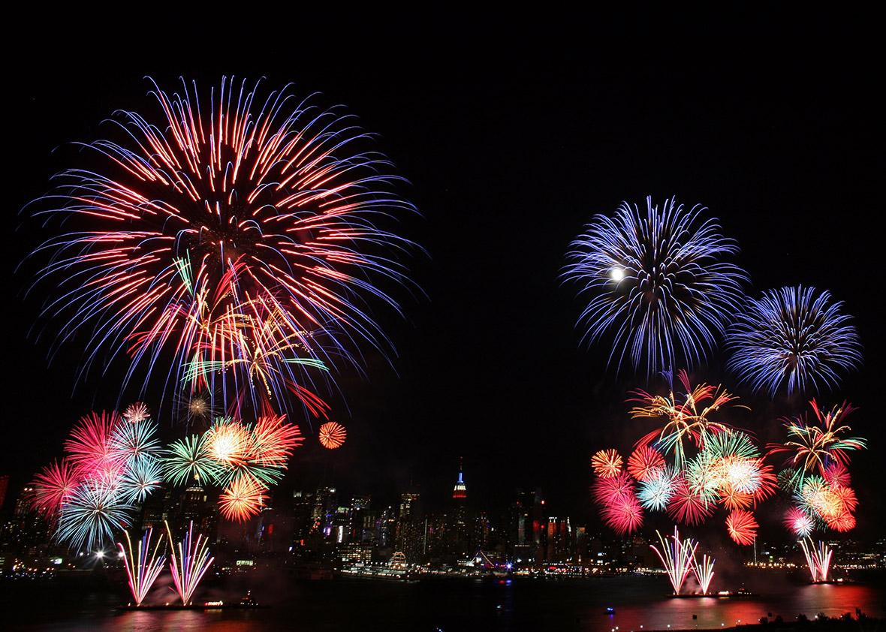
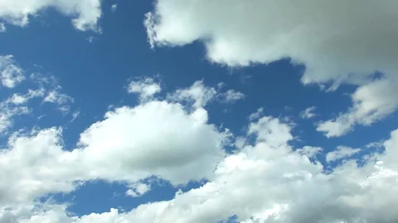
Notes:
When solving the equation of transfer, it is convenient to make a distinction between radiation that is generated by thermal emission of molecules and particulates inside the cloud, which we denote by “dot I,” and radiation in the cloud that has come from external sources like sunlight, or thermal emission of Earth’s surface, which we denote by “double-dot I.”
Without fireworks, shown here, lightning or other unusual events, the atmosphere is too cold to thermally emit much of the near ultraviolet, visible or near infrared wavelengths that are characteristic of sunlight. But as we saw in the geosynchronous satellite images of the Earth, longwave thermal infrared is abundantly emitted by clouds and greenhouse gases.
We are all familiar with the white scattered sunlight from clouds, or blue-sky Rayleigh scattering from N₂ and O₂ molecules.

Slide 16
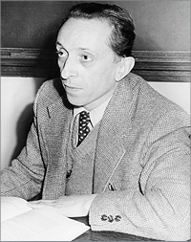
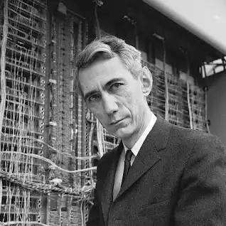
2N-STREAM SAMPLING
Gian Carlo Wick
1909-1992
Claude Shannon
1916-2001
Notes:
An ingenious trick for converting the integral, which represents scattering in the equation of transfer, to a 2n x 2n matrix product is due to the Italian physicist, Gian Carlo Wick. Wick is most noted for his important contributions to field theory. While Wick did postdoctoral research in Leipzig, he was befriended by Werner Heisenberg, and in the year 1932, he became Enrico Fermi’s assistant in Rome.
While studying the diffusion of thermal neutrons, which is very similar to the scattering of radiation in clouds, Wick noted that the scattering integral could be evaluated with a Gaussian quadrature involving 2n sample points. If the the scattering phase could be expanded on the first 2n Legendre polynomials the quadrature would give exactly the same answer as the integral. We can think of Wick’s prescription for sampling spatial directions with discrete angles as analogous to the Shannon-Nyquist sampling of band-limited communication signals at discrete sampling times.
Photos of Wick and Shannon are shown in the viewgraph.

Slide 17
Notes:
For 2n-stream radiation transfer calculations, the axially symmetric phase function, p(μ, μ‘), is replace by a 2n x 2n matrix of sample values
p(μ_{i} μ_{i’}), evaluated at the Gauss-Legendre direction cosines, μ_{i} and μ_{i’}. Some examples are shown in this viewgraph. For simplicity, we assume only 2n = 10 streams of axially symmetric radiation. Scattering for three different input directions are shown, highly vertical on the left, highly horizontal on the right and intermediate in between.
This example is the maximum forward-scattering phase function, that is nonnegative for any input or output direction cosines, and that can be constructed from the first six Legendre polynomials, P₀, P₁, …, P₅ .
Acceptable phase functions are rotationally symmetric, nonnegative and satisfy the sum rule shown on the viewgraph.

Slide 18
http://arxiv.org/abs/2205.09713
Notes:
This figure shows a calculation done with 2n scattering theory. In this example 2n = 10. An isothermal cloud layer is located between the green lines at optical depths 0 and 8 above the bottom. Thermal emission by the cloud particulates is shown as blue rays.
The cloud is illuminated from below by upward blackbody radiation for which the intensity is shown as red rays. The upward incoming rays at the bottom of the cloud are of equal length, since emission from a blackbody has a Lambertian angular distribution. The diffusely-reflected, downward red rays at the cloud bottom are “limb brightened.” The more nearly horizontal reflected rays are more intense than the more vertical rays.
As red radiation experiences multiple scattering in the cloud, much is absorbed and converted to heat. Very little emerges from the top or bottom. Most of the emerging radiation is thermally emitted by cloud particulates and shown as blue rays.

Slide 19
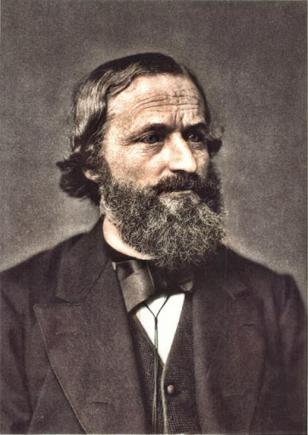
Gustav Kirchhoff
1824-1887
Notes:
For studies of climate, the behavior of radiation inside a cloud is of little importance compared to the properties of radiation escaping from the cloud top to space or from the cloud bottom to irradiate Earth’s surface.
Not surprisingly, the external incoming intensity I^{{in}} , consisting of n upward external streams incident on the bottom of the cloud and n downward external streams, incident on the top of the cloud generates an outgoing intensity I^{{out}} consisting of n upward scattered streams emerging from the top of the cloud, and n downward scattered streams emerging from the bottom of the cloud. The constant of proportionality between the weighted 2n incoming streams I^{{in}} and 2n outgoing streams I^{{out}} is the 2n x 2n scattering matrix S. For real clouds, some fraction of the incoming radiation is always absorbed and heats the scattering particulates
For thermal radiation intensity I^{{out}} emerging from an isothermal cloud, the n upward streams emerging from the top and the n downward streams emerging from the bottom are proportional 2n streams of the isotropic Planck intensity B in the cloud. The constant of proportionality is the emissivity matrix E.
In an interesting generalization of Kirchhoff’s law to 2n-stream scattering theory, the sum of the scattering matrix S and the emissivity matrix E is the identity matrix 1, that is S+E=1. The effects of the scattering matrix S and emissivity matrix E of the previous viewgraph are illustrated on this one.

Slide 20
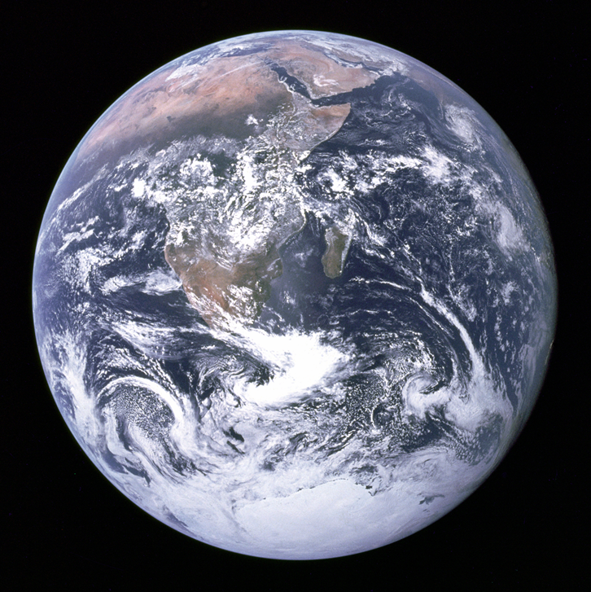
The Blue Marble. A photograph of Earth and its clouds
taken by Lunar astronaut Harrison Schmitt, 7 December, 1972.
TAKE AWAY MESSAGES
Clouds and water vapor are much more important than greenhouse gases for Earth’s climate.
Doubling CO₂ concentration, a 100% increase only decreases radiation to space by 1%. Covering half the sky with clouds decrease solar heating by 50%.
Clouds can be quantitatively modeled with 2n-Stream Radiative Transfer Theory.
Notes:
In the limited time I had available I have tried give the flavor of the role of clouds in Earth’s climate, and I have outlined a powerful theoretical tool for quantitative studies of radiation in clouds, 2n-Stream Radiation Transfer Theory.

